Slide 1


Blood Glucose Prediction Model Applicable to Continuous Glucose Monitoring Systems
Master Thesis Defense
Author: Jiang Yijun
Supervisor: Prof. Shiming Zhang
Department of Electrical and Computer Engineering
The University of Hong Kong
July 2026

Slide 2
Outline
1
Background & Literature Review
2
Data Processing & Filtering
3
General Prediction Models
4
Transfer Learning
5
Meta-Transfer Learning
6
Conclusion

Slide 3
01
Background & Literature Review
Research motivation, CGM technology, data challenges, and literature evolution

Slide 4

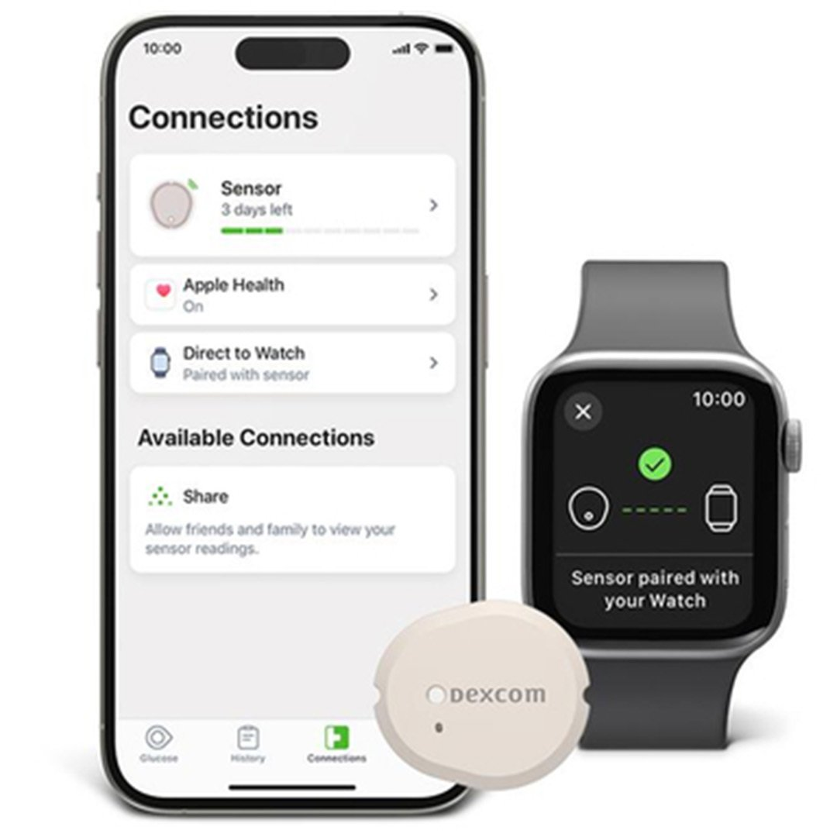
Background
Data Processing
General Models
Transfer Learning
Meta-Transfer
Conclusion
Introduction: A CGM Prediction System for Wearable Devices
If CGM becomes widely adopted (e.g., Apple Watch), what prediction system should we design?
Key requirements for an ideal CGM prediction system:
Real-time 30-minute ahead prediction
Accurate under rapid glucose changes
Personalized to individual physiology
Data-efficient: works with minimal calibration data
Privacy-preserving: local computation
This thesis proposes a complete pipeline using only CGM sequences + age + BMI
No meal logs, no insulin doses, no exercise records needed.

Slide 5
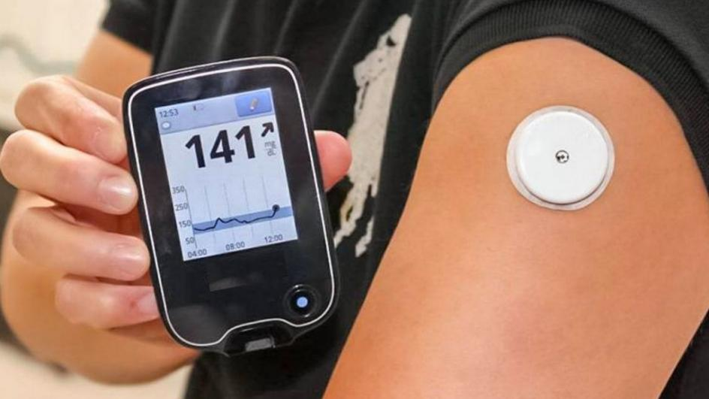
Background
Data Processing
General Models
Transfer Learning
Meta-Transfer
Conclusion
Diabetes Background and CGM Technology
Diabetes mellitus is a chronic metabolic disease with increasing global prevalence, causing serious complications in heart, kidneys, eyes, and nerves.
Traditional measurement limitations:
Fasting glucose, postprandial glucose: single-point only
HbA1c: average over months, misses fluctuations
SMBG: frequent but inconvenient, especially at night
CGM advantages:
5-minute high-frequency sampling
Detailed time series: post-meal, exercise, overnight
New metric: Time in Range (TIR) 3.9-10.0 mmol/L
30-min prediction window for proactive intervention
Figure 1.1 CGM devices provide continuous glucose monitoring through subcutaneous sensors

Slide 6
Background
Data Processing
General Models
Transfer Learning
Meta-Transfer
Conclusion
Challenges in CGM Data and Prediction Task
Physiological Delay
Sensor Noise & Drift
Data Missing
5-10 minute lag between interstitial fluid glucose and blood glucose. During rapid changes (post-meal, post-exercise), dynamic error becomes significant.
Electrochemical sensor degradation, motion artifacts, pressure-induced sensor attenuation (PISA), and electronic system noise.
Sensor signal loss, calibration interruption, device drop, wireless transmission failure lead to gaps in time series.
Prediction Target: 30-60 minutes ahead | Goal: From after-event monitoring to pre-event prediction

Slide 7
Background
Data Processing
General Models
Transfer Learning
Meta-Transfer
Conclusion
Literature Review: Model Evolution
1. Physiological Models
2. Statistical Models
3. Deep Learning
Bergman Minimal Model, Hovorka Model
Differential equations describing glucose metabolism and insulin dynamics
Strong explainability but complex parameter identification, difficult to scale
ARIMA, ARMA, Kalman filtering
Small computational overhead, suitable for short-term forecasts
Limited to linear timing dependencies
RNN, LSTM, GRU, CNN, Transformer
Automatic feature learning, long-range dependency modeling
Current mainstream
Current Research Gap
High-accuracy models rely on multimodal data (meal, exercise, insulin, heart rate) - hard to collect in practice
CGM-only models still need days of data before working well for new users
Individual physiological differences cause generalization failure on some subjects

Slide 8
Background
Data Processing
General Models
Transfer Learning
Meta-Transfer
Conclusion
Research Motivation and Core Objectives
Core Question: Can we achieve accurate glucose prediction using ONLY CGM sequences + age/BMI?
1
Complete Pipeline
2
Systematic Comparison
3
Few-Shot Personalization
Build and test a complete CGM-only prediction framework with S-G filtering, covering data cleaning to model evaluation
Compare 8 models under identical conditions; select Transformer as base model for its accuracy and architectural advantages
Transfer learning + FOMAML meta-learning for rapid personalization with only 30-50 samples (~2.5 hours)
Validation: 174 subjects across healthy, prediabetic, T1D, and T2D populations
Key innovation: "Cloud pre-training + local fine-tuning" privacy-preserving deployment
Clinical impact: Enables real-time personalized glucose prediction from day one of CGM use

Slide 9
02
Data Processing & Filtering
Heterogeneous dataset fusion, standardization, noise analysis, and filtering pipeline

Slide 10
Background
Data Processing
General Models
Transfer Learning
Meta-Transfer
Conclusion
Heterogeneous Dataset Fusion and Standardization
Colas Dataset (T2D)
Hall Dataset (Healthy)
OhioT1DM Dataset (T1D)
Medtronic MiniMed iPro
NGT to prediabetes to T2D
High clinical heterogeneity
Dexcom G4 monitoring
"Glucotypes" concept
Healthy and sub-healthy
12 T1D subjects
Most severe fluctuations
Insulin pump treatment
Full Spectrum: Health → Prediabetes → T2D → T1D | 174 subjects, 117,570 observations
Standardization Pipeline
Table 2.1 Physiological Parameters
1. Field alignment: {id, time, gl, age, bmi}
2. Unit conversion: All to mg/dL
3. Linear resampling: Strict 5-min intervals
4. Missing data:
• ≤15 min: Cubic spline interpolation
• >15 min: Sequence segmentation (exclude <6h)
Metric | Mean±SD | Range
Age (year) | 54.7±13.2 | 25-88
BMI (kg/m²) | 29.1±4.6 | 18-44
Avg BG (mg/dL) | 111.5±38.4 | 40-350

Slide 11

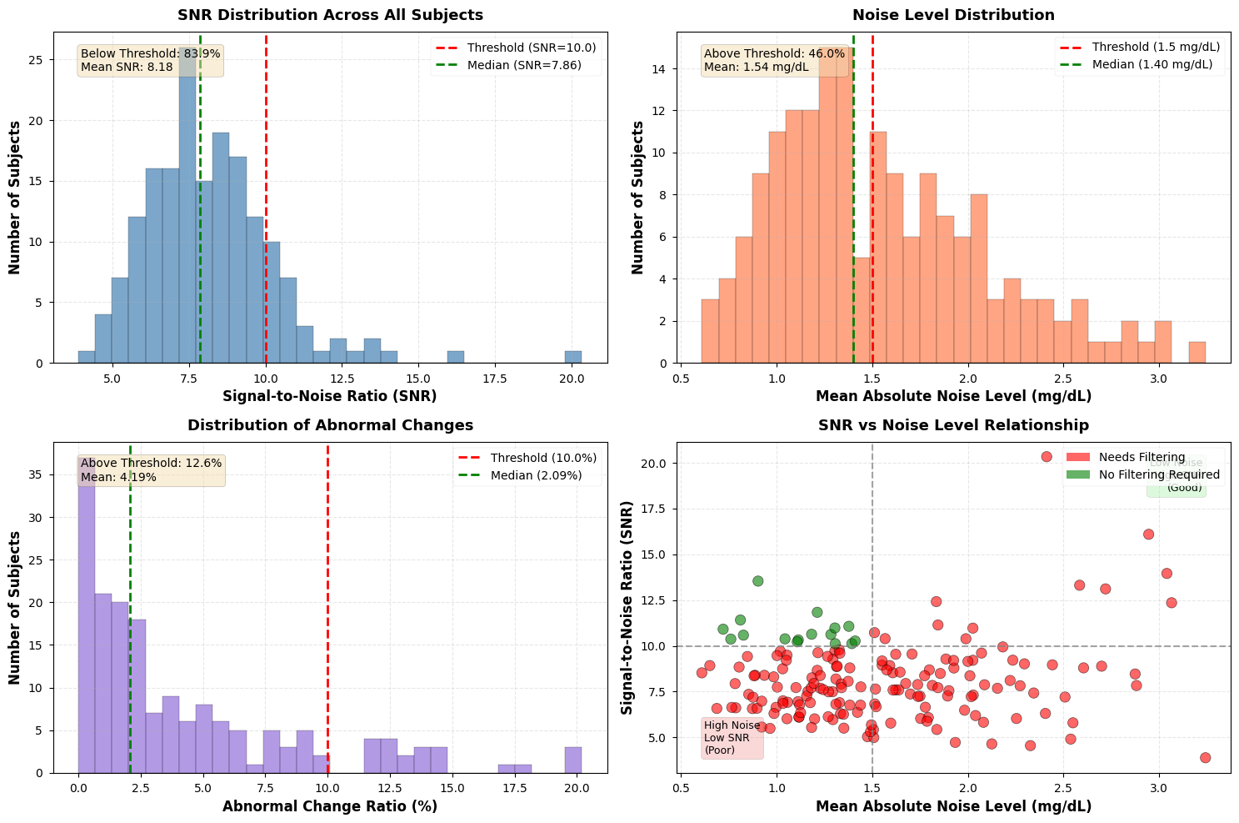
Background
Data Processing
General Models
Transfer Learning
Meta-Transfer
Conclusion
CGM Noise Analysis and Assessment
Four Noise Sources:
1. Electrochemical sensor inherent noise and enzyme electrode aging
2. Physiological delay (5-15 min) and dynamic error during rapid changes
3. Motion artifacts and PISA (pressure-induced sensor attenuation)
4. Thermal noise and quantization error in ADC
Three Evaluation Metrics:
• Noise Std Dev (threshold: 1.5 mg/dL)
• SNR (threshold: 10.0)
• Abnormal change ratio (threshold: 10%)
Result: 90.8% of 174 subjects need filtering
Figure 3.1 (1)SNR (2)Noise level (3)Anomaly ratio (4)Scatter plot

Slide 12
Background
Data Processing
General Models
Transfer Learning
Meta-Transfer
Conclusion
Filtering Theory and Evaluation
Table 3.2 Comparison of Filtering Results
Index | Kalman | S-G Filter | Butterworth | Ideal
NRR (%) | -6.6±3.7 | 14.0±6.2 | 18.8±7.1 | High
SNR | 7.9±2.0 | 9.4±2.2 | 9.9±2.3 | High
PPR | 1.009±0.005 | 0.987±0.007 | 0.972±0.008 | ≈1.0
Phase Lag (min) | 1.7±2.4 | 0 | 0 | 0
Analysis & Conclusion
Kalman: Negative NRR and phase lag - not suitable for prediction input
Butterworth: Highest noise removal (18.8%) but attenuates peaks (PPR 0.972) - loses 3% per peak
S-G Filter: Best balance - moderate denoising (14.0%) with excellent peak preservation (PPR 0.987)
Conclusion: S-G selected for preserving local extrema without delay
Zero phase lag ensures strict timeline alignment; third-order polynomial fits glucose smooth curves

Slide 13
03
General Prediction Models
Problem definition, baseline models, deep learning architectures, and comprehensive evaluation

Slide 14
Background
Data Processing
General Models
Transfer Learning
Meta-Transfer
Conclusion
Problem Definition and Evaluation Metrics
Prediction Task Definition
Evaluation Metrics
Task: Supervised time series regression
Input: Past 12 CGM readings (60 min) + age + BMI
Output: Glucose at 6 steps ahead (30 min horizon)
Data split: Past-Future Split
• Last 6h as test set
• 10 hold-out subjects for independent validation
Statistical:
MAE, RMSE, MAPE, RMSPE
Clinical: Clarke Error Grid Analysis (CEGA)
• Zone A: Clinically accurate (±20%)
• Zone B: Clinically acceptable
• Zones C/D/E: Dangerous - overcorrection / failure / erroneous
Clarke Error Grid Zones:
Zone A - Accurate within 20% or hypoglycemia range | Zone B - Deviation >20% but no improper treatment | Zone C - Overcorrection
Zone D - Failure to detect dangerous events | Zone E - Completely wrong treatment direction
Target: >95% predictions in Zone A+B for clinical applicability

Slide 15
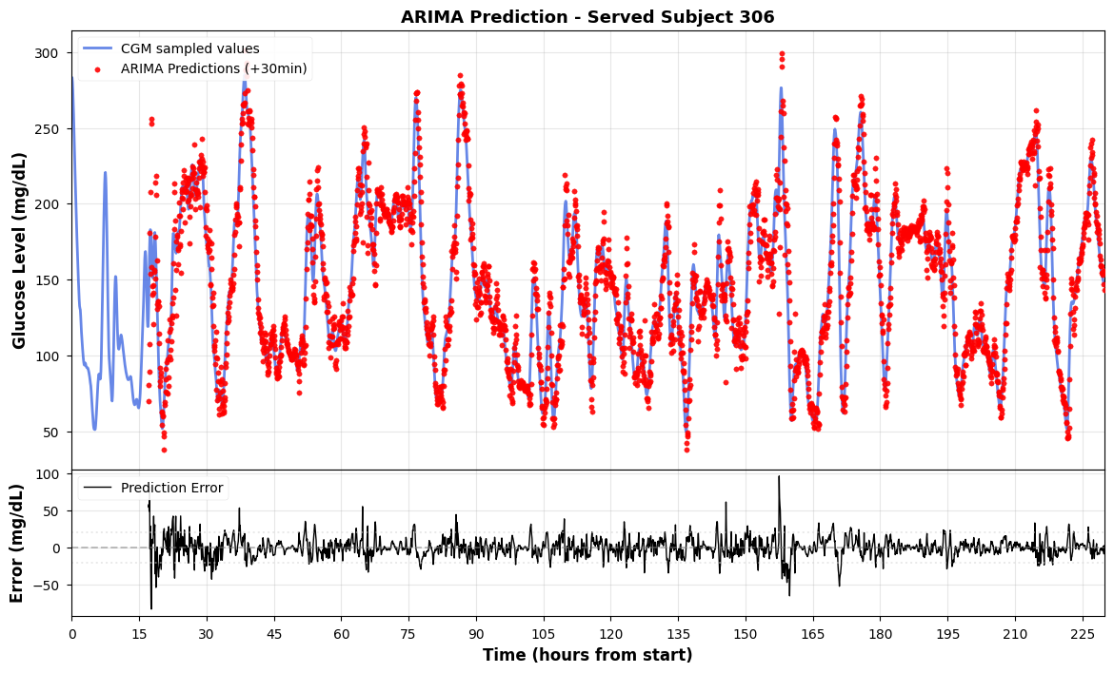
Background
Data Processing
General Models
Transfer Learning
Meta-Transfer
Conclusion
Baseline and Machine Learning Models
ARIMA (RMSE 8.96): Univariate only, no static features
Linear (RMSE 8.53): Surprisingly competitive - sliding window encodes recent trend
KNN (RMSE 15.63): Worst performer - nonstationary dynamics cause mean regression
Random Forest (RMSE 10.28): Bootstrap aggregation regularizes
XGBoost (RMSE 12.33): Tight fit sensitive to distribution shift
Common flaw: All show prediction lag during rapid glucose changes
Linear cannot capture nonlinear dynamics; needs new observation to respond to trend reversal
Figure 4.1 ARIMA prediction on Subject 306 (RMSE 8.96)
Traditional models rely on linear assumptions and handcrafted features - need deep learning for nonlinear glucose dynamics

Slide 16
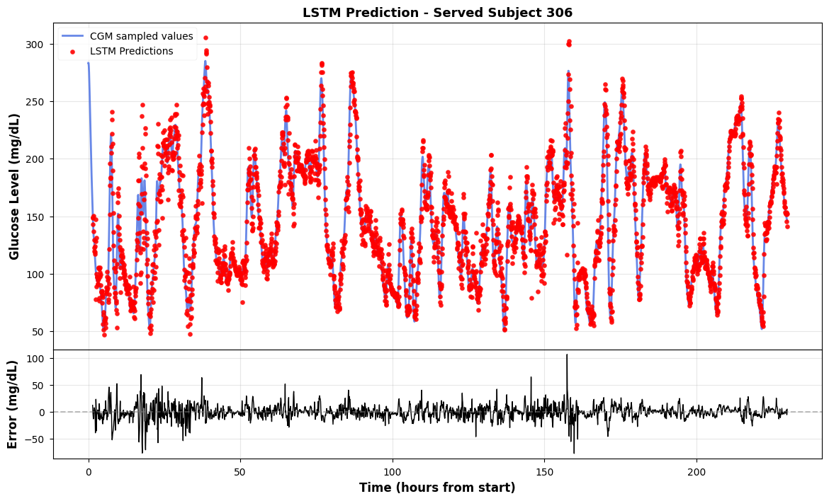
Background
Data Processing
General Models
Transfer Learning
Meta-Transfer
Conclusion
Deep Learning Sequence Models
CNN (RMSE 8.70): 1D convolution captures local slope patterns; translation invariance
RNN (RMSE 11.03): Gradient vanishing limits long-term capture
LSTM (RMSE 8.19): Best overall - gates selectively remember trends
Key insight: LSTM's selective memory fits glucose data
• Remembers trend from 10 min ago
• Ignores noise spike 5 min ago
• Recent rate of change matters more than absolute level
Figure 4.8 LSTM prediction on Subject 306 (RMSE 8.19 - best overall)
LSTM achieves best RMSE but Transformer offers unique structural advantages for transfer learning

Slide 17
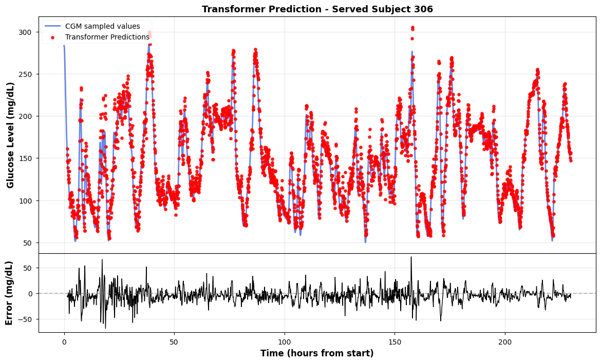
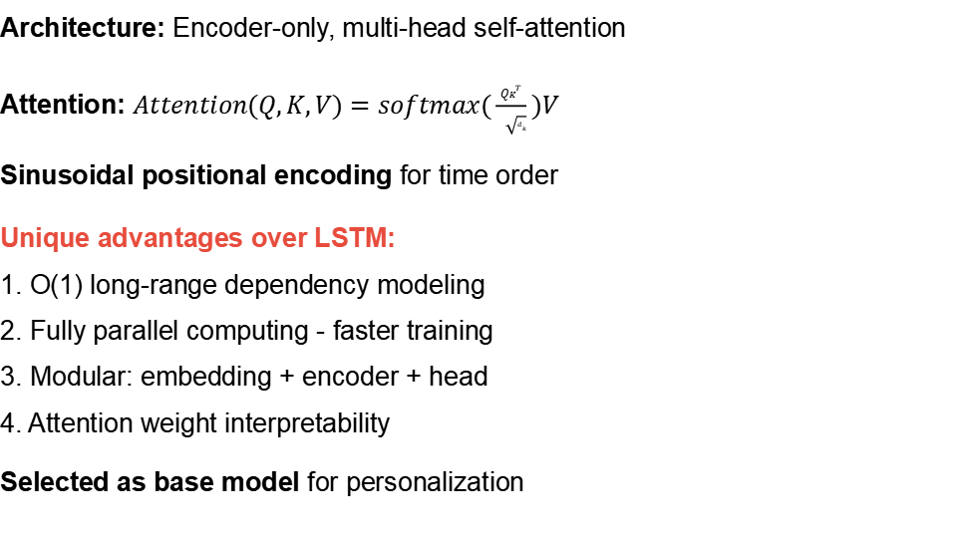
Background
Data Processing
General Models
Transfer Learning
Meta-Transfer
Conclusion
Transformer Architecture and Advantages
Architecture: Encoder-only, multi-head self-attention
Attention: $Attention(Q,K,V)=softmax(\frac{QK^{T}}{\sqrt{d_{k}}})V$
Sinusoidal positional encoding for time order
Unique advantages over LSTM:
1. O(1) long-range dependency modeling
2. Fully parallel computing - faster training
3. Modular: embedding + encoder + head
4. Attention weight interpretability
Selected as base model for personalization
Figure 4.9 Transformer prediction on Subject 306 (RMSE 9.14)
Transformer: slightly behind LSTM in RMSE but superior architecture for transfer learning

Slide 18
Background
Data Processing
General Models
Transfer Learning
Meta-Transfer
Conclusion
Comprehensive Performance Comparison
Table 4.1 Nine Models Comparison (30-min horizon)
Model | MAE | RMSE | MAPE(%) | RMSPE(%) | CEG A+B(%)
ARIMA | 5.80 | 8.96 | 4.47 | 6.91 | 99.8
Linear | 5.23 | 8.53 | 4.38 | 6.83 | 99.8
KNN | 11.33 | 15.63 | 9.95 | 13.63 | 93.4
Random Forest | 6.64 | 10.28 | 5.58 | 8.23 | 99.2
XGBoost | 8.22 | 12.33 | 6.98 | 10.14 | 98.1
CNN | 5.41 | 8.70 | 4.55 | 7.08 | 99.8
RNN | 7.47 | 11.03 | 6.33 | 8.93 | 99.0
LSTM | 5.02 | 8.19 | 4.27 | 6.74 | 99.8
Transformer | 6.50 | 9.14 | 5.78 | 8.00 | 99.6
Key findings: LSTM best overall (RMSE 8.19); Transformer close (9.14) with superior architecture for transfer learning; KNN unsuitable (15.63); All except KNN achieve >99% clinical safety

Slide 19
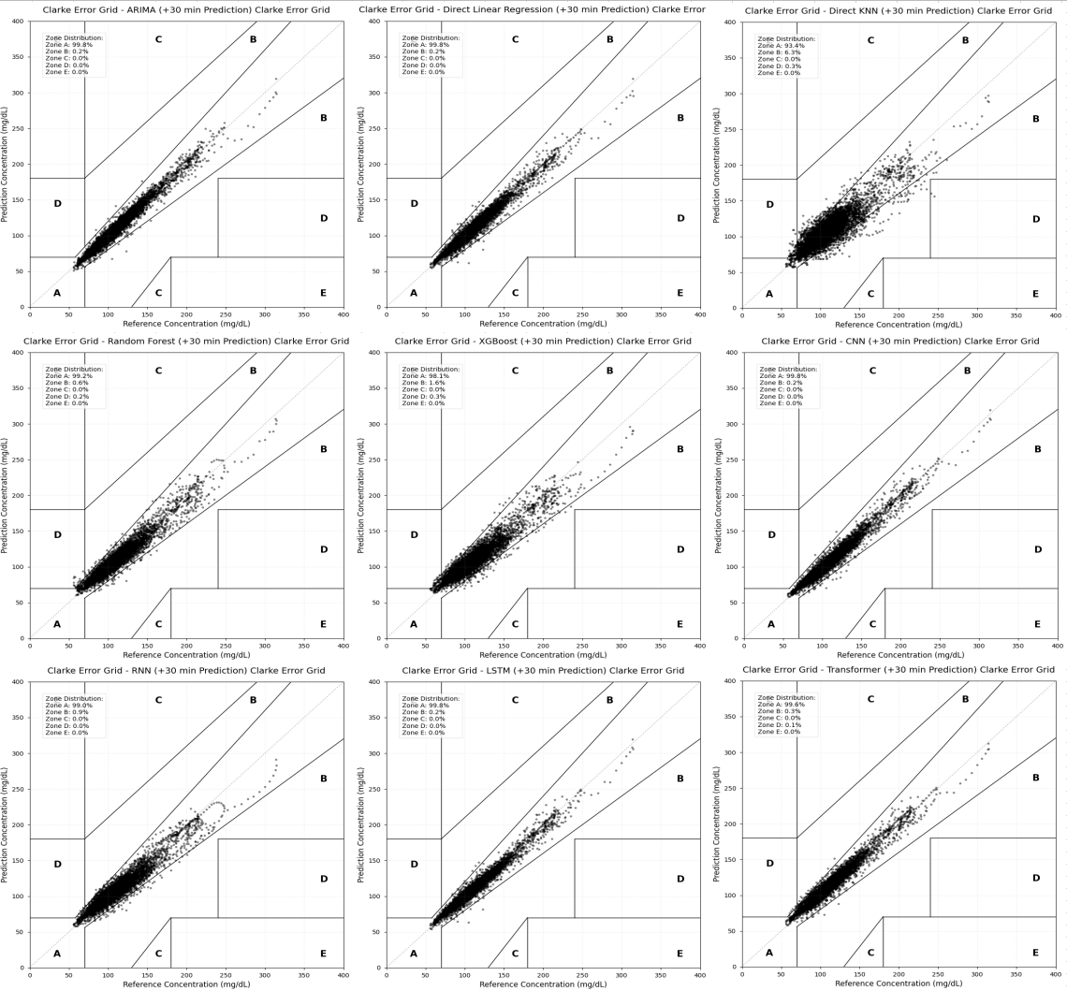
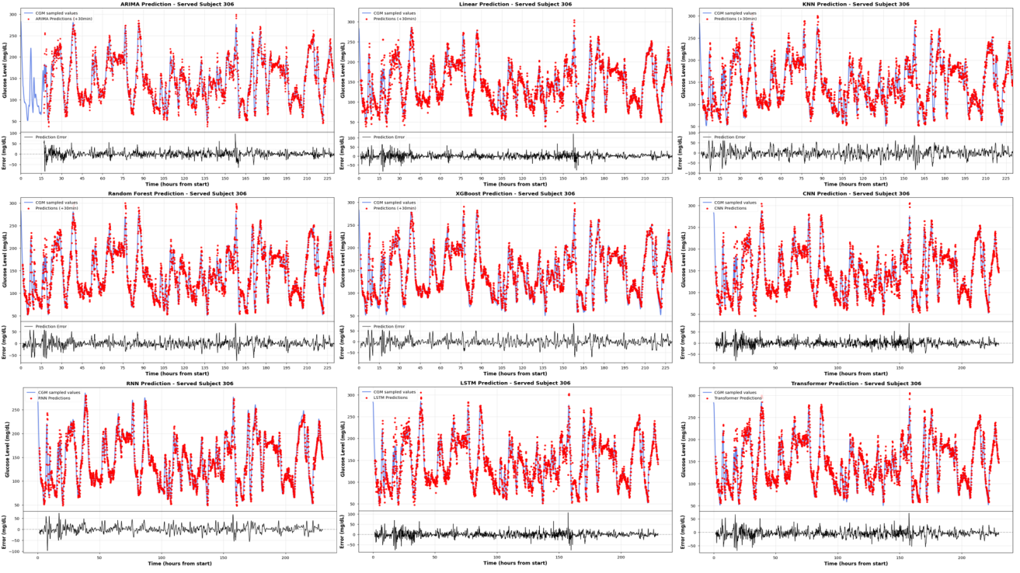
Background
Data Processing
General Models
Transfer Learning
Meta-Transfer
Conclusion
Clinical Safety (CEGA) and Waveform Analysis
Figure 4.10 CEG Clarke Error Grid for all 9 models
Figure 4.11 Waveform comparison on Subject 306
CEGA Results: All models except KNN achieve >99% in A+B zones. LSTM, Linear, CNN, ARIMA reach 99.8% Zone A.
Waveform Analysis (Subject 306):
• Stable period: All models similar - historical values provide sufficient info
• Rapid change: Traditional models show 5-10 min phase lag; LSTM/Transformer respond acutely
• Deep learning extracts second-order dynamics (acceleration, curvature) for trend anticipation

Slide 20
Background
Data Processing
General Models
Transfer Learning
Meta-Transfer
Conclusion
Limitations of General Models
Despite excellent overall performance, some subjects still show high prediction error
Root Cause: Individual Differences
The "Cold Start" Problem
Insulin sensitivity varies across individuals
Gastric emptying rate differs significantly
Metabolic rate and eating habits differ
General model sacrifices specific individuals to reduce average error
New users expect predictions from day one
But general model needs population data
Individual adaptation required on top of general model
Solution direction: Transfer Learning
Next: Transfer Learning for Rapid Personalization

Slide 21
04
Transfer Learning
Frozen-encoder strategy for rapid personalization with limited individual data

Slide 22
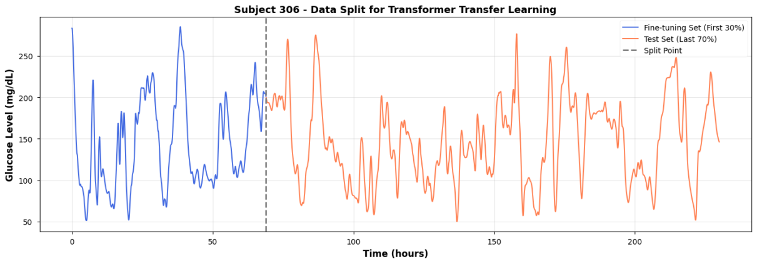
Background
Data Processing
General Models
Transfer Learning
Meta-Transfer
Conclusion
Transfer Learning Strategy: Freeze Encoder
Strategy: Pre-train → Fine-tune
Transformer decoupled into:
• Encoder: learns general glucose dynamics (shared)
• Regression Head: maps to individual-specific levels
Freeze encoder during fine-tuning, update only head
Why? 30% data (~2-3 days) too few to update all parameters
10 hold-out subjects for verification
Figure 5.1 Data split for transfer learning on Subject 306
Two-Step Process
1. Pre-train
Train on all population data
2. Fine-tune
Freeze encoder, update head
3. Personalized Model
Ready for prediction

Slide 23
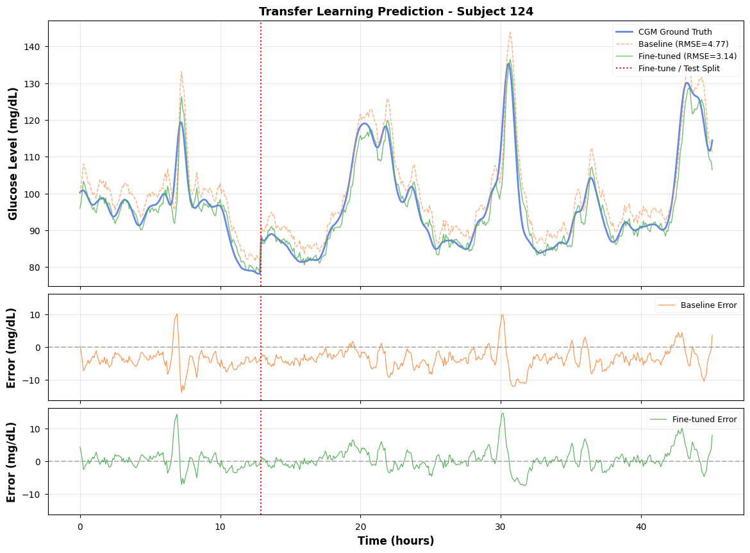
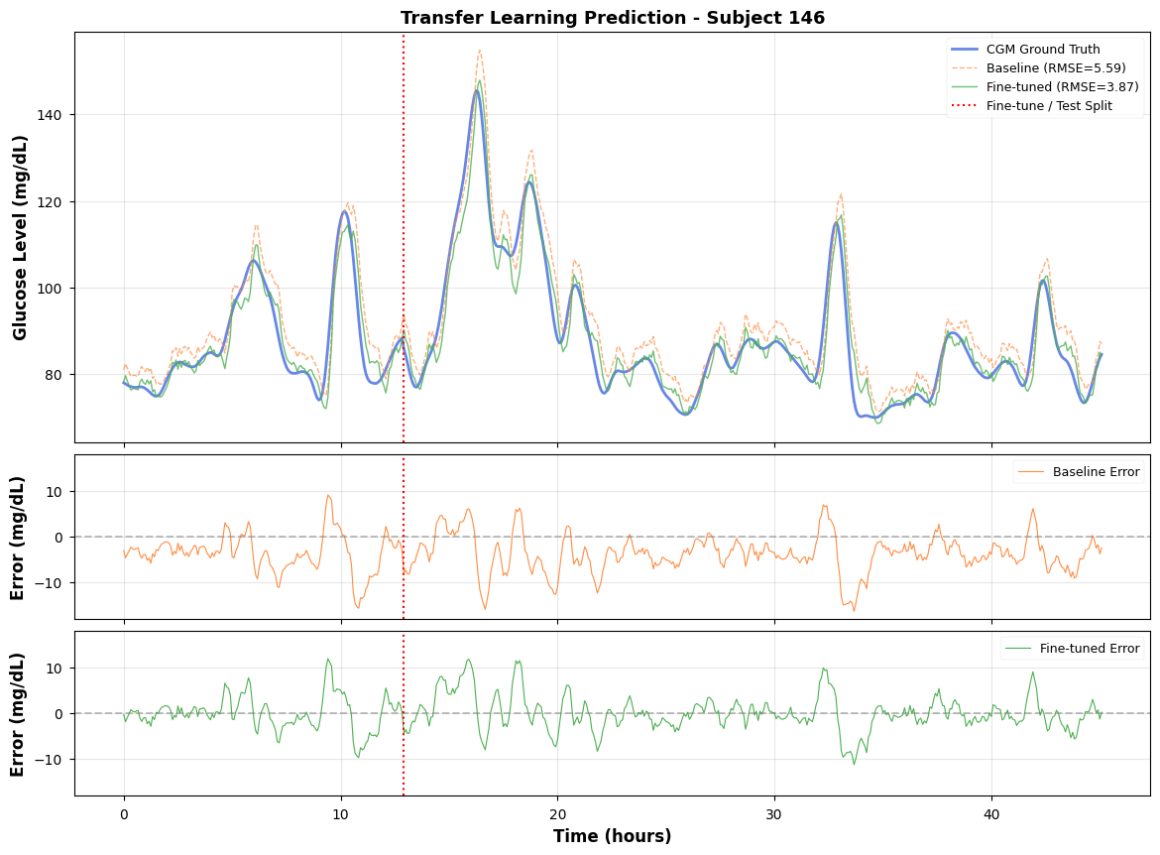
Background
Data Processing
General Models
Transfer Learning
Meta-Transfer
Conclusion
Transfer Learning Results and Waveform Improvement
Figure 5.2 Subject 124: RMSE improved 34.08%
Figure 5.3 Subject 146: RMSE improved 30.82%
Table 5.3 Transfer Learning on 10 Subjects (RMSE)
ID | 2 | 27 | 49 | 71 | 98 | 124 | 146 | 170 | 192 | 306
Baseline | 6.42 | 4.41 | 8.40 | 4.91 | 6.51 | 4.77 | 5.59 | 5.13 | 4.47 | 13.59
Improve | +18.9% | +16.6% | +9.2% | +35.5% | +1.4% | +34.1% | +30.8% | +19.6% | +32.3% | +6.6%
Average RMSE reduction across 10 subjects: 20.35%

Slide 24
05
Meta-Transfer Learning
FOMAML framework for extreme few-shot personalization (30-50 samples)

Slide 25
Background
Data Processing
General Models
Transfer Learning
Meta-Transfer
Conclusion
Clinical Dilemma: Extreme Few-Shot Scenario
What if only one day data is available? 30-50 samples (~2.5 hours)
Standard transfer learning fails:
• Prediction head cannot move far enough from pre-trained weights
• Standard pre-training optimizes average loss across all subjects
• Not close to best weights for any one person
Meta-learning solution:
Instead of optimizing for average fit, optimize initialization for rapid adaptation
Find parameter point where a few gradient steps produce large error drop
FOMAML Key Difference
Standard Pre-training:
Minimize average loss: θ* = argmin ΣL(f_θ, D_i)
FOMAML:
Optimize for fast adaptation:
θ* = argmin ΣL(f_θ', D_i^query)
where θ' = θ - α∇L(f_θ, D_i^support)
Outer objective evaluates performance AFTER adaptation
First-Order approximation eliminates Hessian computation - suitable for resource-limited devices

Slide 26
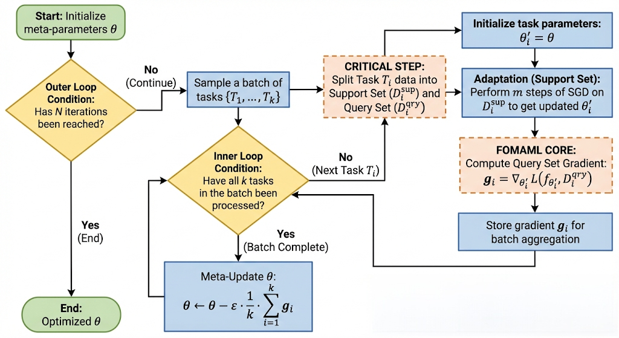
Background
Data Processing
General Models
Transfer Learning
Meta-Transfer
Conclusion
FOMAML Framework and Implementation
Meta-Training Config
Iterations: 1000
Meta learning rate: 1e-4
Task batch size: 8
Inner loop steps: 5
Inner loop lr: 1e-3
Support/Query size: 64
Warm Start: Initialize with pre-trained Transformer weights
Task Definition
Each subject = independent task
• Support Set: small subset for adaptation
• Query Set: evaluate adaptation
Meta-objective: learn initialization enabling rapid adaptation to any new task
Figure 6.1 FOMAML algorithm framework

Slide 27
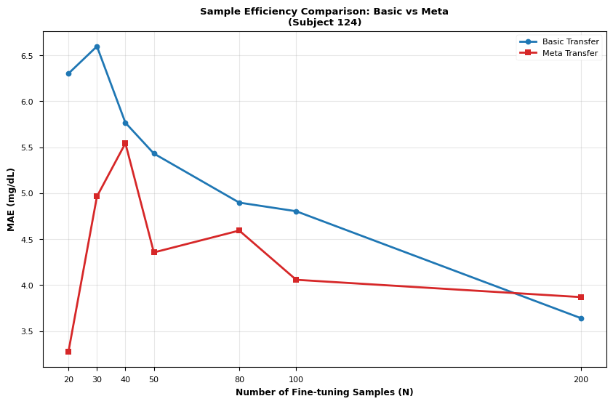
Background
Data Processing
General Models
Transfer Learning
Meta-Transfer
Conclusion
Learning Curves: Basic vs Meta Transfer
Key Findings
N < 100 samples:
MAE reduced by 25.67% on average
N < 40 samples:
MAE dropped by 31.58%
N > 150 samples:
Two methods converge
Value of meta-learning specifically in low-sample regime where starting point matters most
Table 6.2 N=30 Comparison
Metric | Basic | Meta
MAE | 5.94 | 5.38
RMSE | 6.49 | 6.21
Figure 6.2 Learning curve: Basic Transfer vs Meta Transfer (Subject 124)

Slide 28
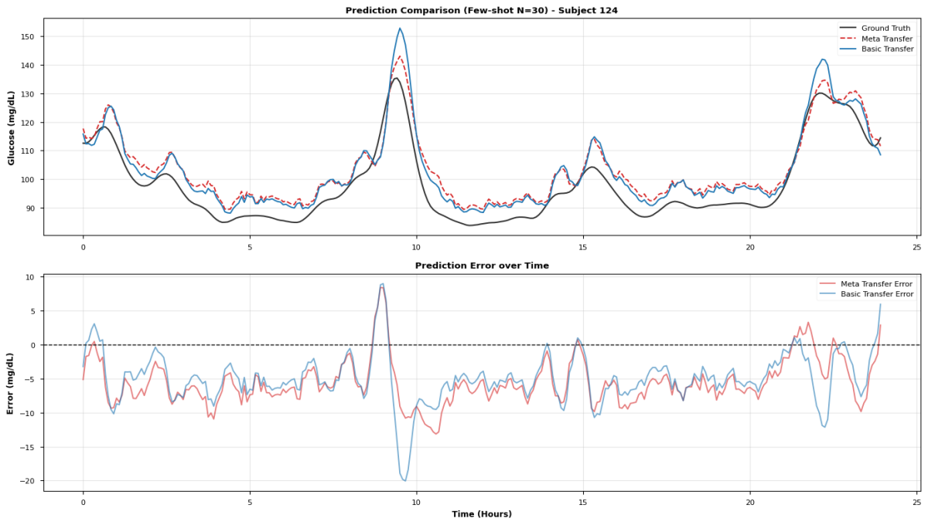
Background
Data Processing
General Models
Transfer Learning
Meta-Transfer
Conclusion
Few-Shot Waveform Consistency Analysis (N=30)
Detailed Observations
Rapid rise (post-meal):
• Meta Transfer tracks peak accurately
• Basic Transfer shows overshoot
Change points:
• Meta Transfer responds faster
• Significantly reduced phase lag
Stable phase:
• Similar average performance
• Meta Transfer has smaller variance
Meta Transfer: lower error + more stable
Figure 6.3 Prediction comparison on Subject 124 with only 30 samples (~2.5 hours)
Meta Transfer not only reduces average error but also reduces error fluctuation

Slide 29
06
Conclusion
Core contributions summary and future directions

Slide 30
Background
Data Processing
General Models
Transfer Learning
Meta-Transfer
Conclusion
Core Scientific Contributions
1
Preprocess Pipeline
2
Transformer Base Model
3
FOMAML Few-Shot Learning
• Sy
• Overcomes phase lag via self-attention
• O(1) long-range dependency modeling
• Modular architecture for transfer learning
• 8 models systematically compared
• Personalization from 30-50 samples
• MAE reduction 31.58% in extreme cases
• Edge-device instant personalization
• Privacy-preserving local deployment
Engineering Value
"Cloud pre-training + local fine-tuning" architecture:
• Cloud: Train general model on population data
• Device: Download pre-trained model
• Local: Fine-tune with user's first 2.5 hours of data
• Result: Personalized predictions from day one, no data uploaded to cloud

Slide 31

Thank You
Questions & Answers
Jiang Yijun
Department of Electrical and Computer Engineering
The University of Hong Kong
Supervisor: Prof. Shiming Zhang
July 2026

